Slide 1

LWC Training
Security with Lightning Locker
MAY 7, 2019
Day 4 : Security with Lightning Locker

Slide 2
Day 4 Training
agenda
What is Lightning Locker?
Security with Lightning Locker

Slide 3
What is Lightning Locker?

Slide 4
Technical design
Introduction
Powerful security architecture for Lightning components. Provides component isolation and security that allows code from many sources to execute and interact with each other.
Promotes best practices that improve the supportability of your code by only allowing access to supported APIs and eliminating access to non-published framework internals.
Creating a Form to Work with Records
Creating a Form to Work with Records

Slide 5
Security with Lightning Locker

Slide 6
Technical design
JavaScript Strict Mode Enforcement
Lightning Locker implicitly enables JavaScript strict mode everywhere. It makes code more secure, robust, and supportable.
Common stumbling points when using strict mode are:
You must declare all variables. Use any of the var, let, or const declarations in libraries or modules.
To share code between components, you must export variables and functions from modules and import them into other modules. See Share JavaScript Code for more details.
Eg: const calculateMonthlyPayment = (principal, years, rate) => { // Logic };
export { calculateMonthlyPayment }; (Owner Component)
import { getTermOptions, calculateMonthlyPayment } from 'c/mortgage’; (Importing Component)
The libraries that your components use must also work in strict mode.
For more information about JavaScript strict mode, see the Mozilla Developer Network.
Creating a Form to Work with Records

Slide 7
Technical design
Secure Wrappers
Lightning Locker restricts the use of global objects by hiding an object or by wrapping it in a secure version of the object.
Some methods and properties have different behavior or aren’t available on the secure objects.
The different secure objects available for LWC are :
SecureWindow - Available for LWC and Aura Components.
SecureDocument - Available for LWC and Aura Components.
SecureObject - Available for LWC and Aura Components.
SecureLightningElement - Available for LWC.
SecureTemplate - Available for LWC.
Creating a Form to Work with Records
Creating a Form to Work with Records

Slide 8
Technical design
Considerations/Limitations with Secure Wrappers
SecureWindow
If a Lightning web component and an Aura component belong to the same namespace, they share the same SecureWindow instance.
SecureDocument
It represents the root node of the HTML document or page. The document object is the entry point into the page’s content, which is the DOM tree.
If a Lightning web component and an Aura component belong to the same namespace, they share the same SecureDocument instance.
SecureObject
When you see a SecureObject, it typically means that you don’t have access to the underlying object and its properties aren’t available.
Creating a Form to Work with Records

Slide 9
Technical design
Considerations/Limitations with Secure Wrappers
SecureLightningElement
Lightning web components extend the LightningElement base class, and at runtime Locker switches the class with SecureLightningElement.
Do not extend SecureLightningElement directly.
Not Supported APIs –
Element.attachShadow(), Element.getElementsByClassName(), Element.getElementsByTagName(), Element.shadowRoot—use this.template instead, Element.slot.
SecureTemplate
Secure wrapper for the template object, which represents a shadowRoot node.
There are many APIS which are not supported, few of them are -
Node.localName, Node.namespaceURI, Node.nodeValue, DocumentFragment.getElementById(), ParentNode.append, ParentNode.prepend , DocumentOrShadowRoot.elementsFromPoint().
Creating a Form to Work with Records

Slide 10
Technical design
DOM Access Containment
A component can only traverse the DOM and access elements that it created. This behavior prevents the anti-pattern of reaching into DOM elements owned by other components.
Lightning web components can’t use the window or document global properties to query for DOM elements. Every component has a shadow tree. The component owns the elements in its shadow tree. To access these elements, use the template property.
For example, use this.template.querySelector() instead of document.querySelector(). You can also use element.template.querySelector
For more information , refer Access Elements the Component Owns.
Creating a Form to Work with Records

Slide 11
Technical design
Restricted Access To Salesforce Global Variables
Lightning Locker blocks access to some global JavaScript objects that are available to other Salesforce features.
2. Lightning web components don't have access to:
$A
Aura
Sfdc
Sforce
3. Locker restricts access to these for Lightning web components because they are either deprecated or would lead to cross-framework dependencies.
Creating a Form to Work with Records

Slide 12
Technical design
Content Security Policy Overview
The Lightning Component framework uses Content Security Policy (CSP), which is a W3C standard, to control the source of content that can be loaded on a page. CSP helps prevent cross-site scripting (XSS) and other code injection attacks. All CSP rules work at the page level, and apply to all components and libraries.
The framework enables these specific CSP rules:
JavaScript Libraries
HTTPS Connections for Resources
Inline JavaScript
Note : IE11 doesn’t support CSP, so we recommend using other supported browsers for enhanced security.
For more information , refer CSP Overview .
Creating a Form to Work with Records

Slide 13
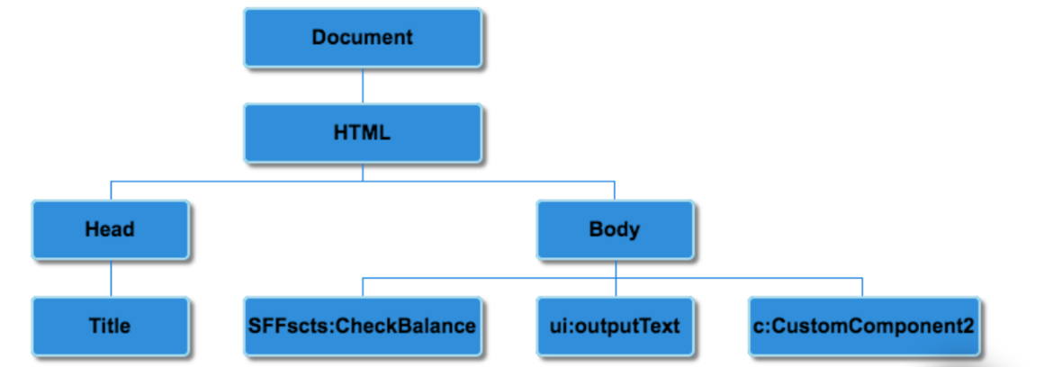
Technical design
Without Lightning Locker Service
Creating a Form to Work with Records

Slide 14
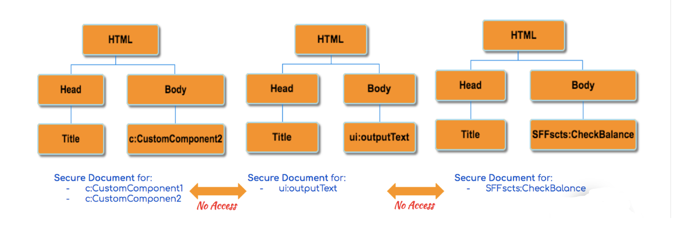
Technical design
With Lightning Locker Service
Creating a Form to Work with Records
For Lightning Web Components, Locker Service is always enabled, you can’t turn it off.

Slide 15
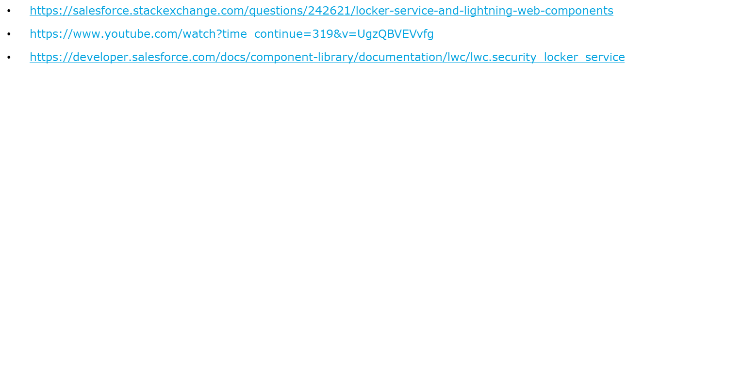
Technical design
References
Creating a Form to Work with Records

Slide 16
Questions

Slide 17
1. Which of the following object is the entry node into the page’s content in LWC?
SecureWindow
SecureDocument
SecureTemplate
SecureLightningElement
2. Which are the two global DOM properties that LWC cannot use?
Window
this
element
document
3. What does CSP do?
Prevent cross site scripting
Prevent Code injection attack
Enable JavaScript Libraries
All of the above.

